Slide 1
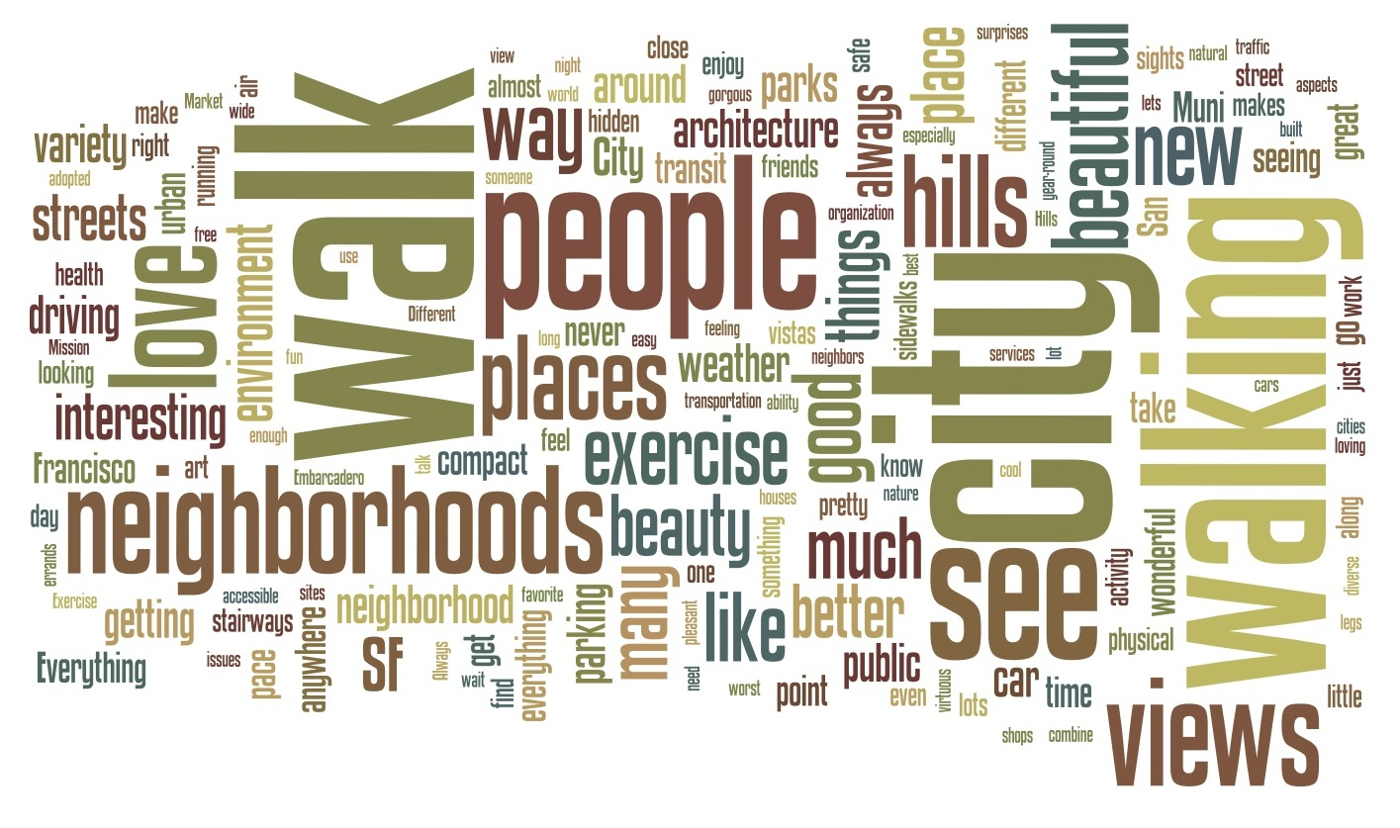

Walkability
Presented By:
Tylor Mondloch, Francisco Solis,
Oscar Ruvalcaba, and Regina Guerre

Slide 2
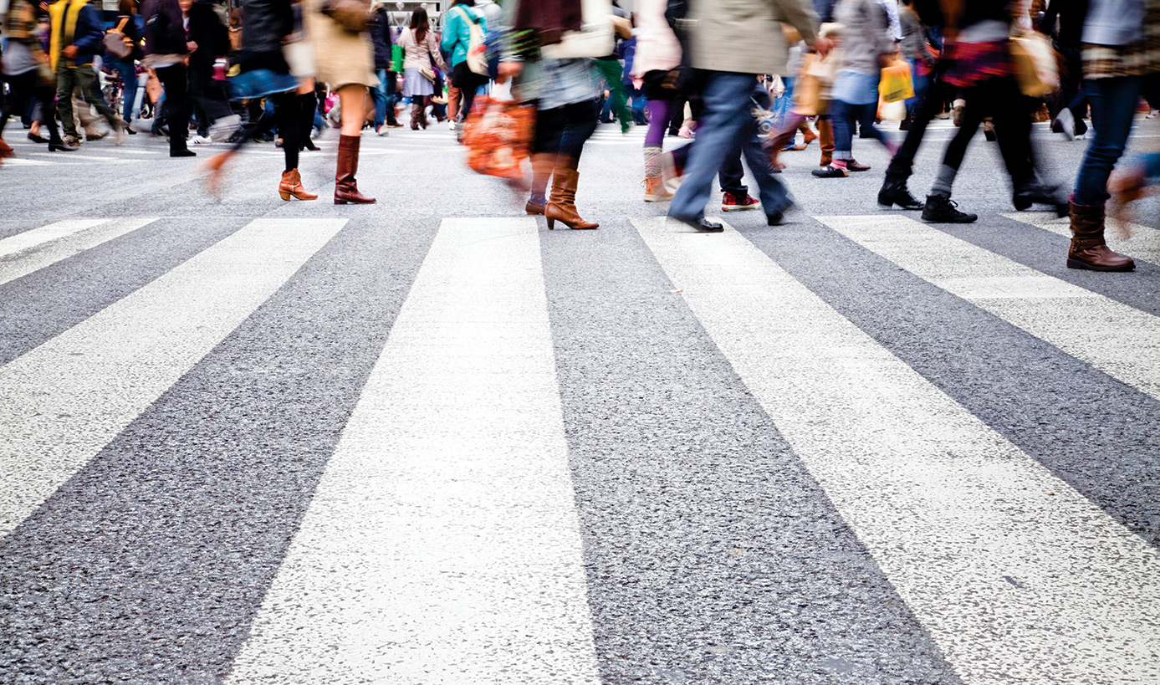
Research Topic & Goals
Theme
Why are certain parts of Anaheim Street more suitable for walkability?
Research Questions
Is there a correlation between walkability and socio-economic levels?
Do demographics reflect any spatial patterns?
Notes:
Regina 2min

Slide 3
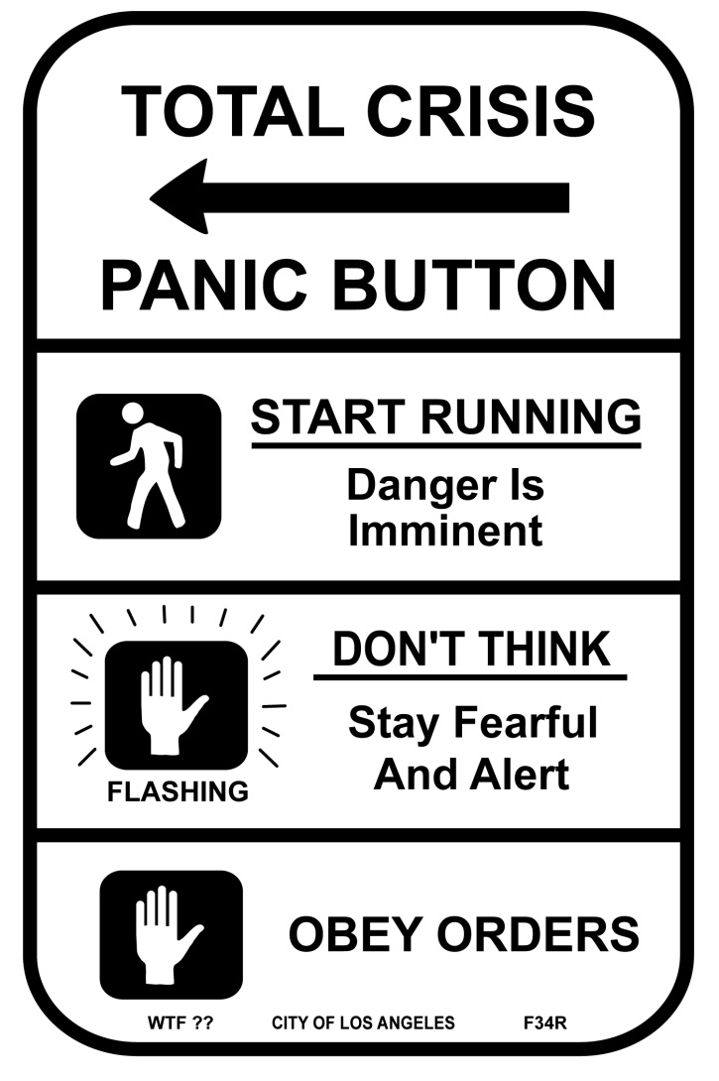
Human Geographic Concepts
Distribution
Spatial Variation
Spatial Association
Spatial Interaction
Sense of Place
Notes:
Regina 1 min

Slide 4

Literature Review
Urban Planning & Health Equity (Blacksher & Lovasi 2012; Northridge & Freeman 2011)
Destinations that Matter (Cerin et al 2007)
Neighborhood Built Environment & Income (Pivo & Fisher 2011; Sallis et al 2009)
Place-Focused Physical Activity Research, Human Agency, & Social Justice in Public Health (Blacksher & Lovasi 2012)
The Walkability Premium in Commercial Real Estate Investments (Pivo & Fisher 2011)
Perception of Environmental Obstacles to Commuting Physical Activity in Brazilian Elderly (Corseuil et al 2011)
Notes:
Francisco 2 min

Slide 5
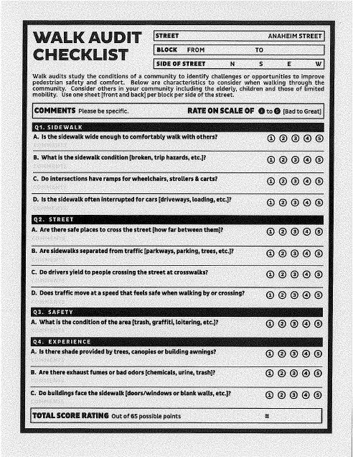
Methods of Data Collection
Participant Observation
Survey
GIS Data
longbeach.gov
Notes:
Francisco 3min max

Slide 6
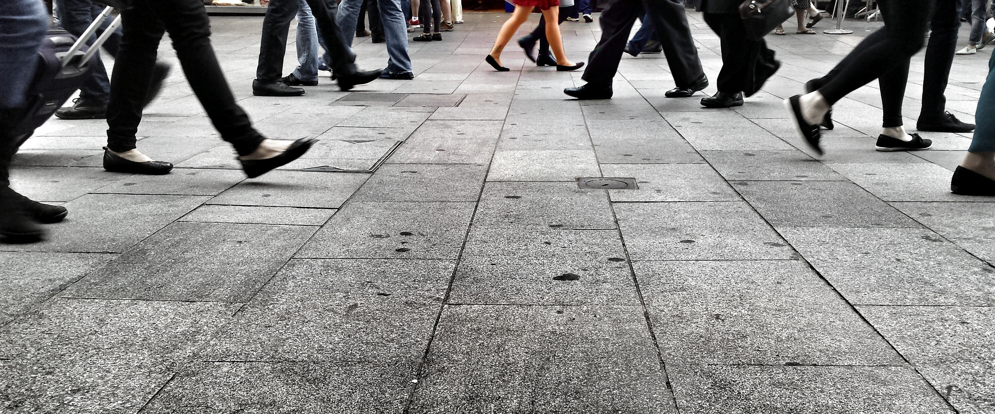


Methods of Analysis
GIS
Altering Shapefiles
Merging Data
Exploring Correlation
Notes:
Oscar/Tylor 4min max

Slide 7
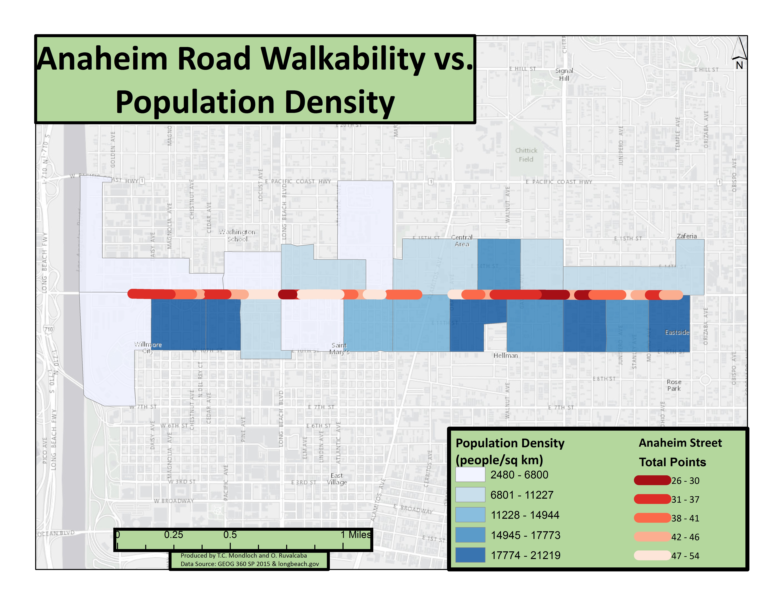

Slide 8
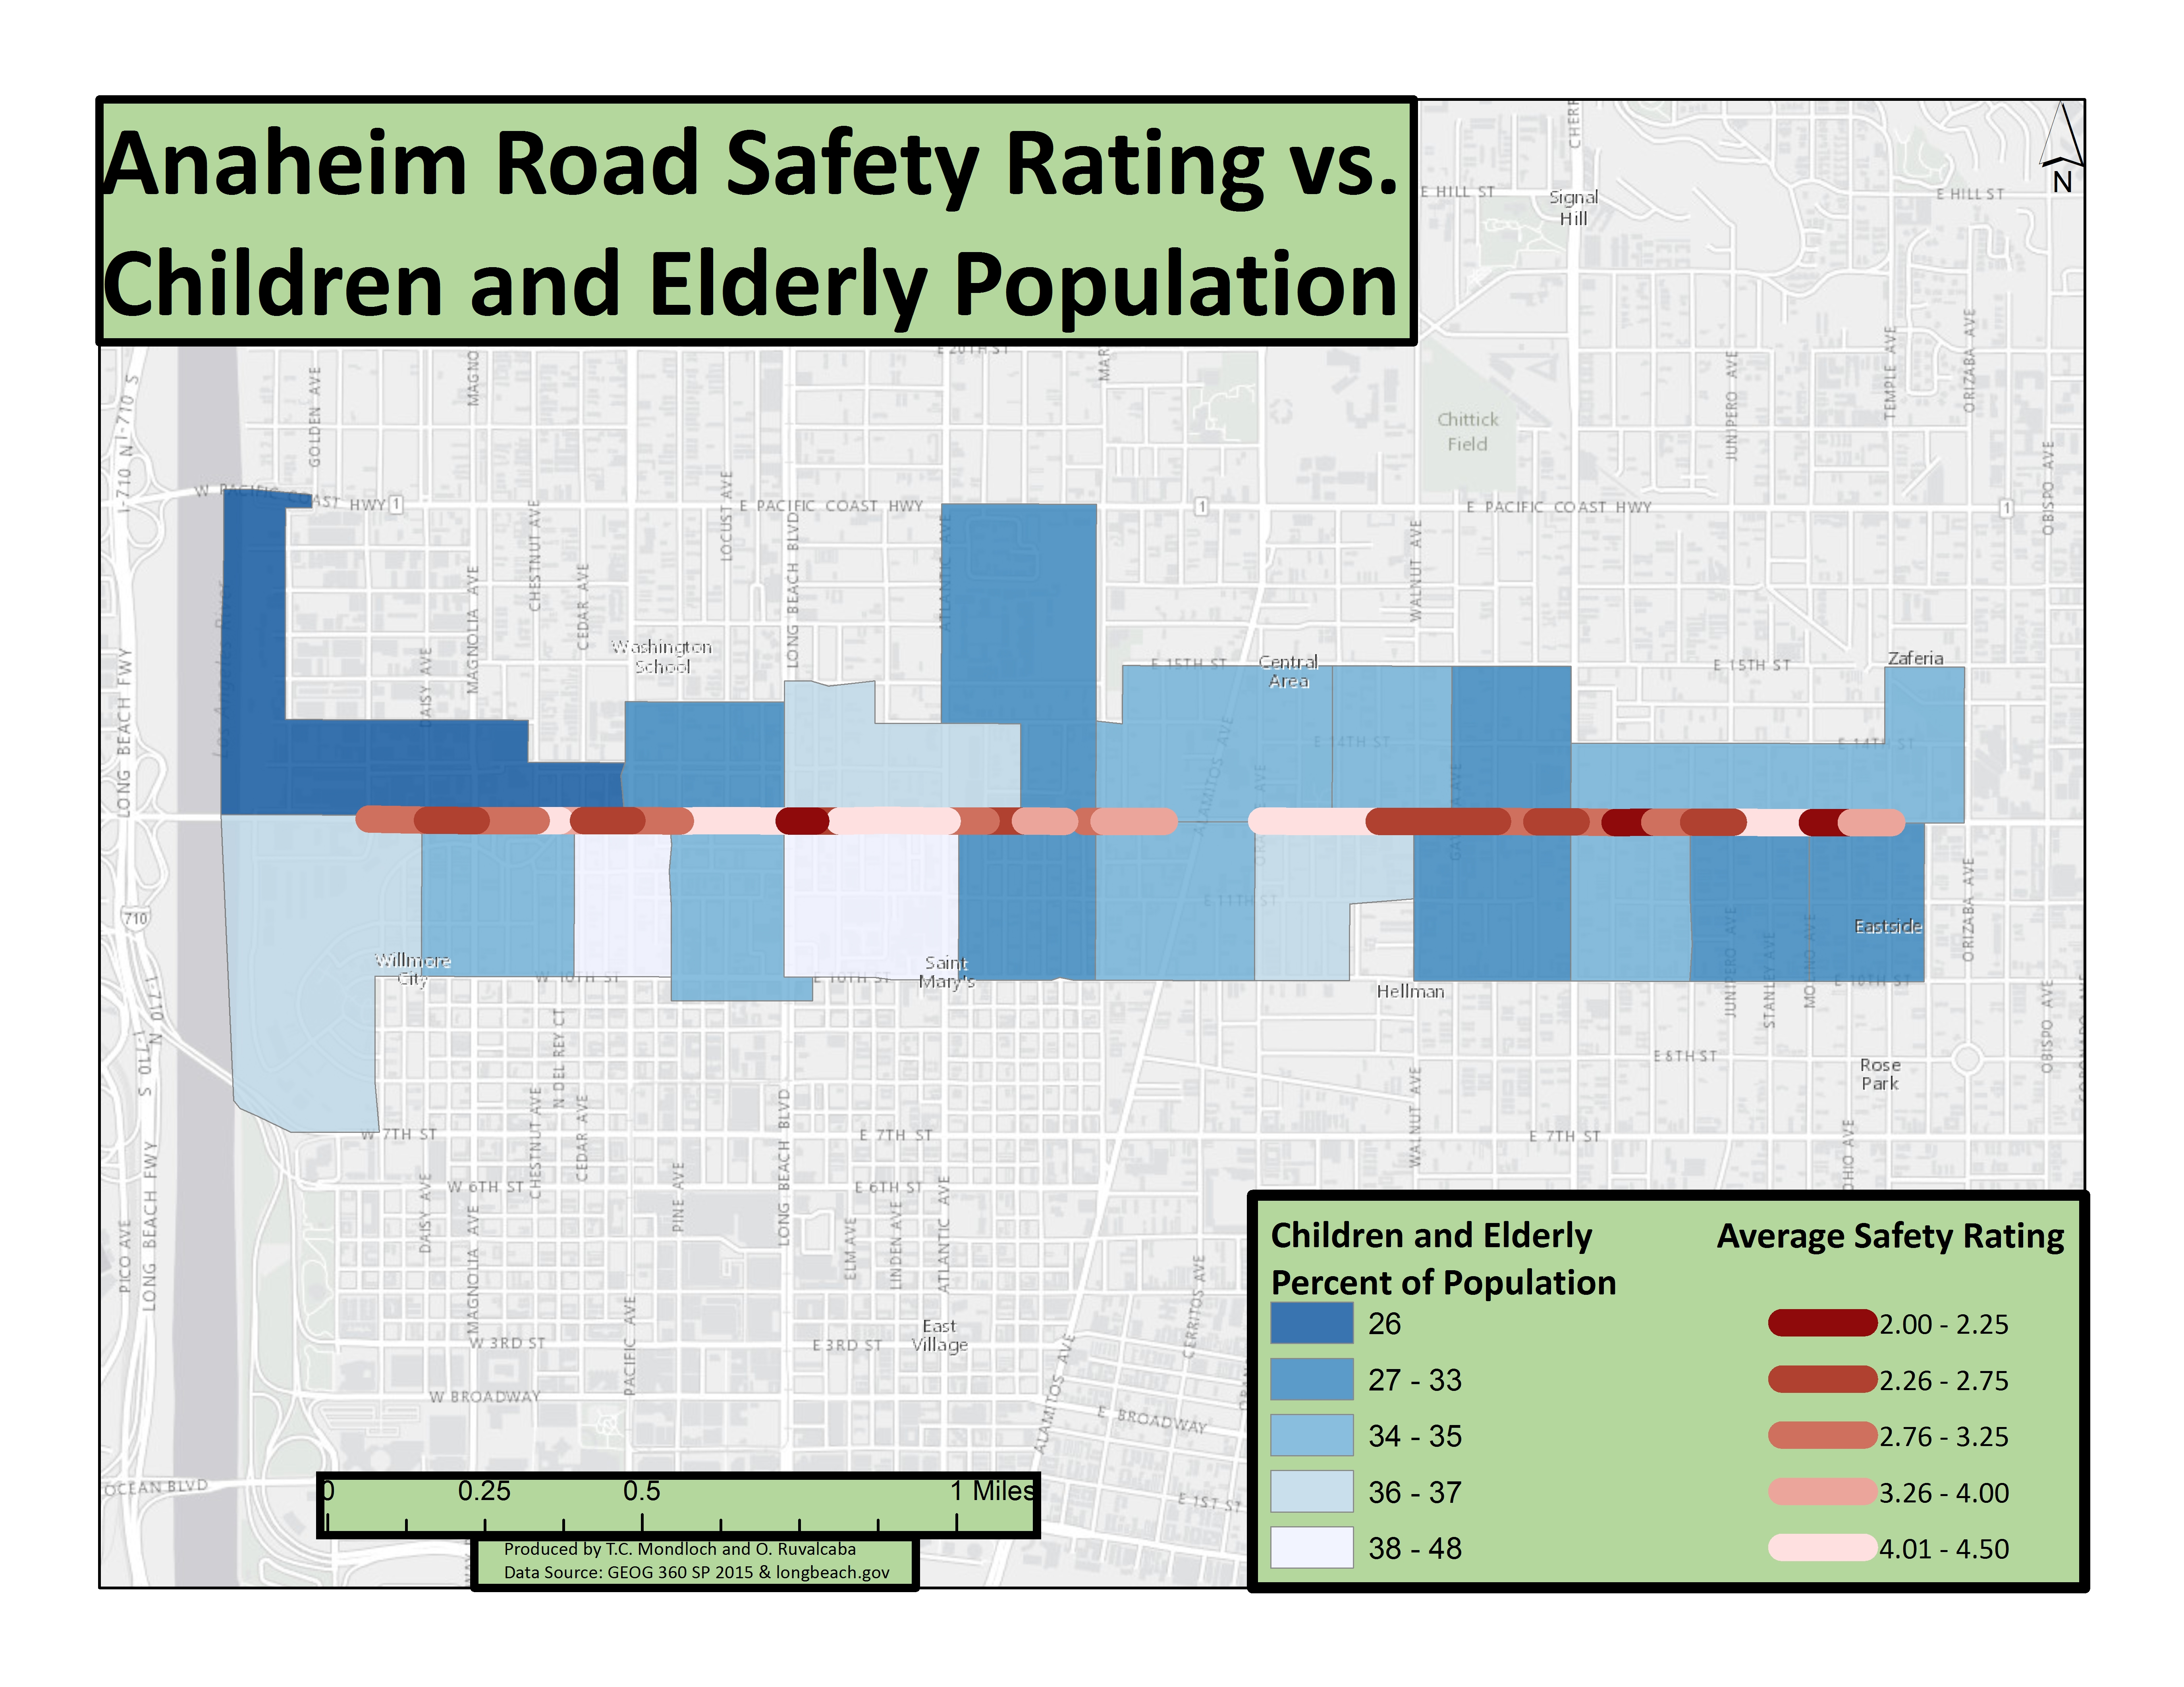

Slide 9
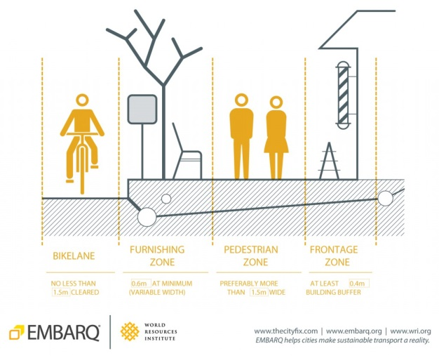
Results
Below Average Safety Ratings
87% chance adjacent to neighborhood with fewer children/elderly than average
Below Average Walkability
89% chance adjacent to a neighborhood with above average population density
Notes:
Tylor 2 min

Slide 10

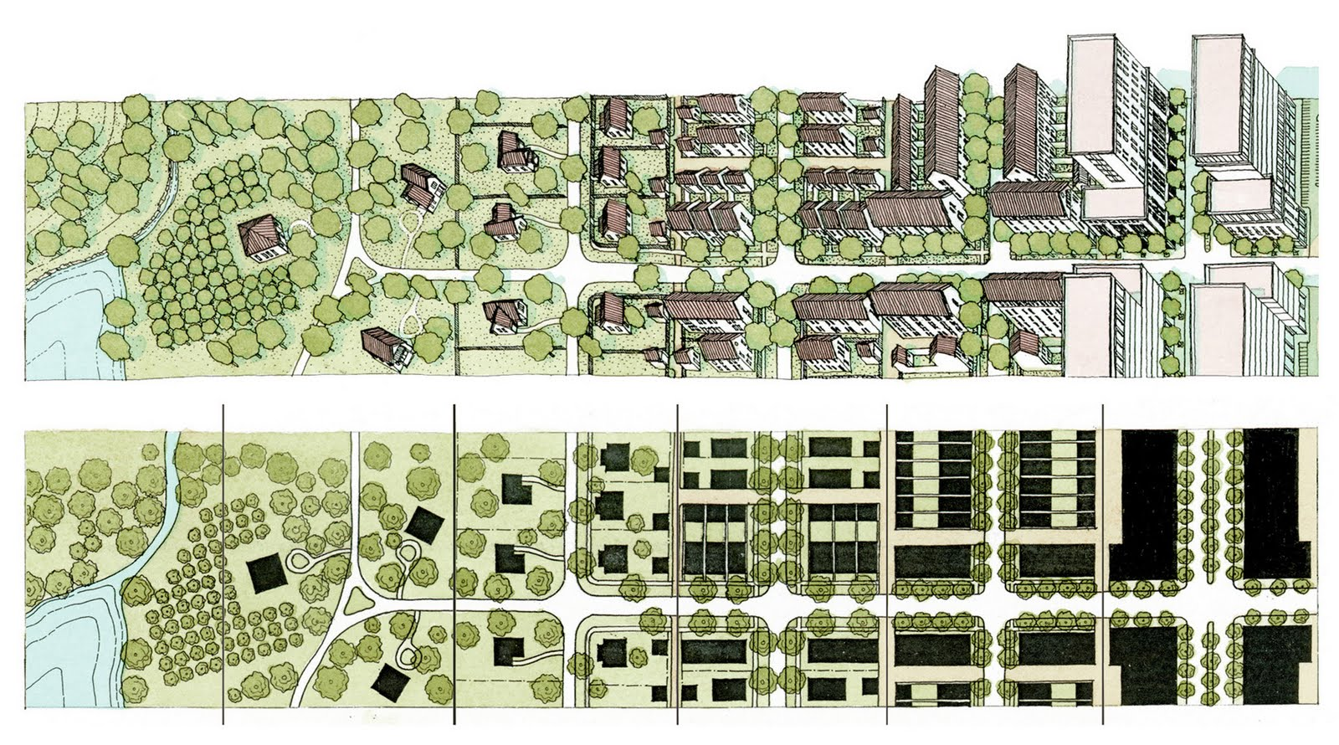
Conclusions
Distribution
Spatial Variation/Association/Interaction
Sense of Place
Notes:
Oscar 1 min

Slide 11
Reference Page
Articles
Blacksher, E., & Lovasi, G. S. (2012). Place-focused physical activity research, human agency, and social justice in public health: Taking agency seriously in studies of the built environment. Health & Place, 18(2), 172-179. doi:10.1016/j.healthplace.2011.08.019
Cerin, E., Leslie, E., Toit, L. d., Owen, N., & Frank, L. D. (2007). Destinations that matter: Associations with walking for transport.Health & Place, 13(3), 713-724. doi:10.1016/j.healthplace.2006.11.002
Corseuil, M. W., Schneider, I. C., Silva, D. S., Costa, F. F., Silva, K. S., Borges, L. J., & d'Orsi, E. (2011). Perception of environmental obstacles to commuting physical activity in Brazilian elderly. Preventive Medicine, 53(4/5), 289-292. doi:10.1016/j.ypmed.2011.07.016
Northridge, M., & Freeman, L. (2011). Urban Planning and Health Equity. Journal of Urban Health, 88(3), 582-597. doi: 10.1007/s11524-011-9558-5
Pivo, G. , & Fisher, J. (2011). The walkability premium in commercial real estate investments. Real Estate Economics, 39(2), 185-219. doi: 10.1111/j.1540-6229.2010.00296.x
Sallis, J. F., Saelens, B. E., Frank, L. D., Conway, T. L., Slymen, D. J., Cain, K. L., & ... Kerr, J. (2009). Neighborhood built environment and income: Examining multiple health outcomes. Social Science & Medicine, 68(7), 1285-1293. doi:10.1016/j.socscimed.2009.01.017
Background & Supplemental Images
Found from Google Images
Is it Walkable?
Google Maps Street View, various parts of Portland, Oregon Accessed April 23, 2015

Slide 12
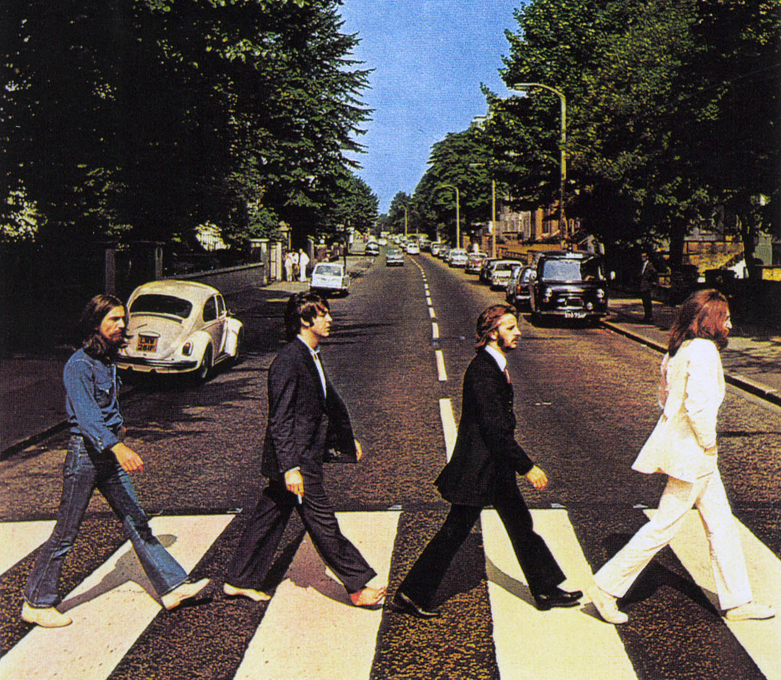
Any Questions?

Slide 13
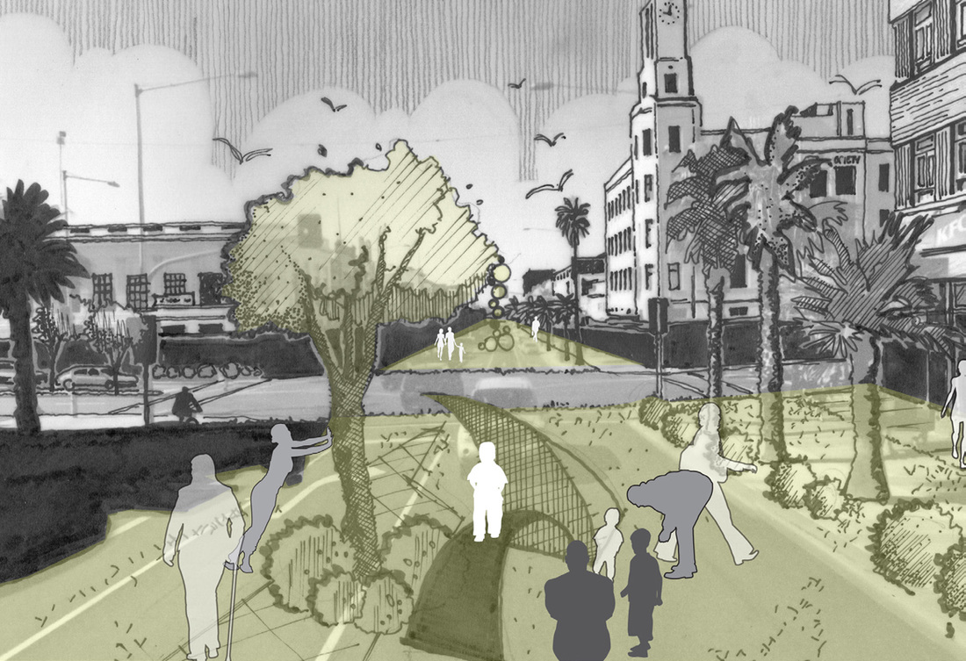
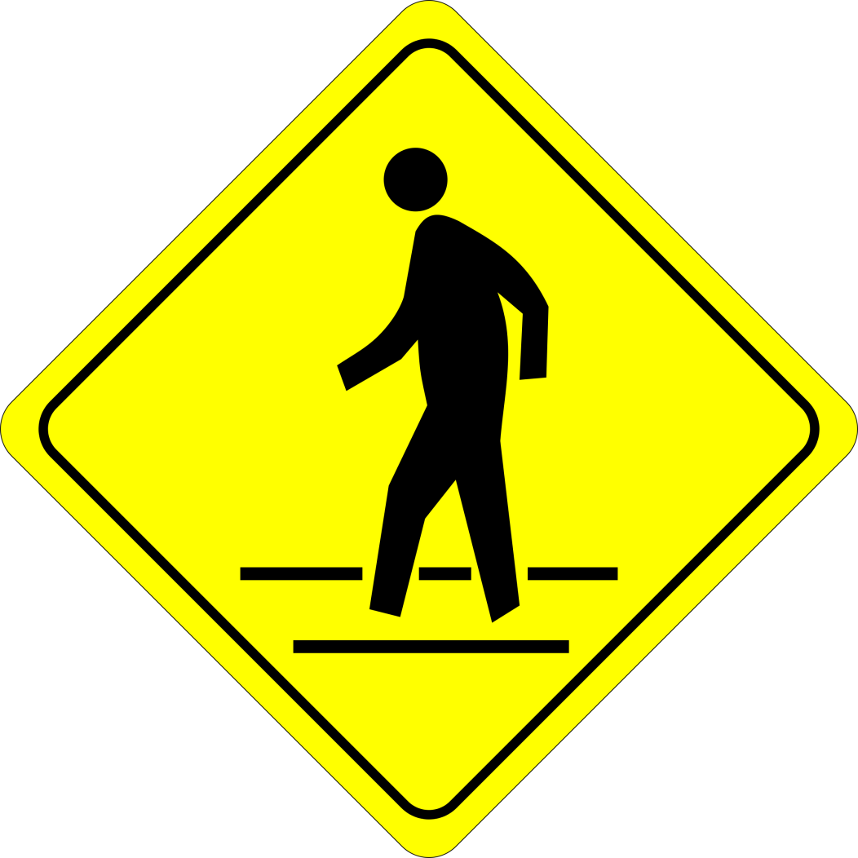

Is it walkable?

Slide 14
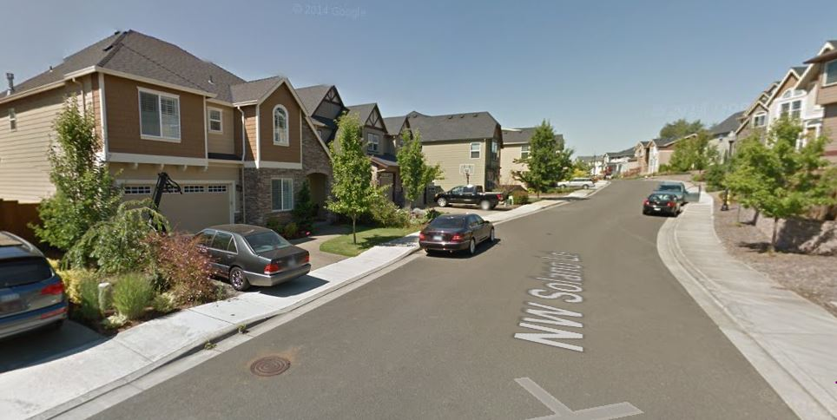
Is it walkable?

Slide 15
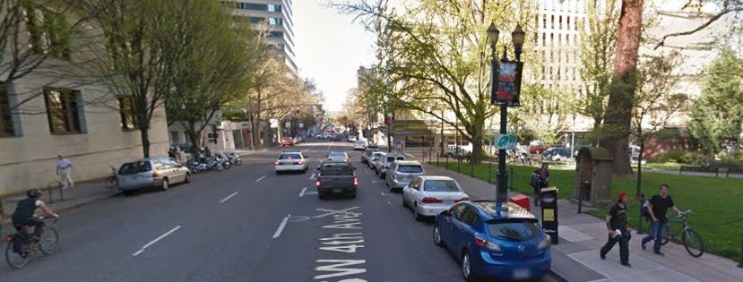
Is it walkable?

Slide 16
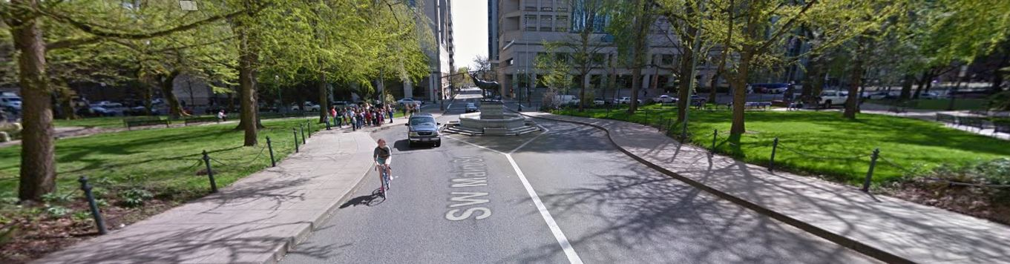
Is it walkable?

Slide 17
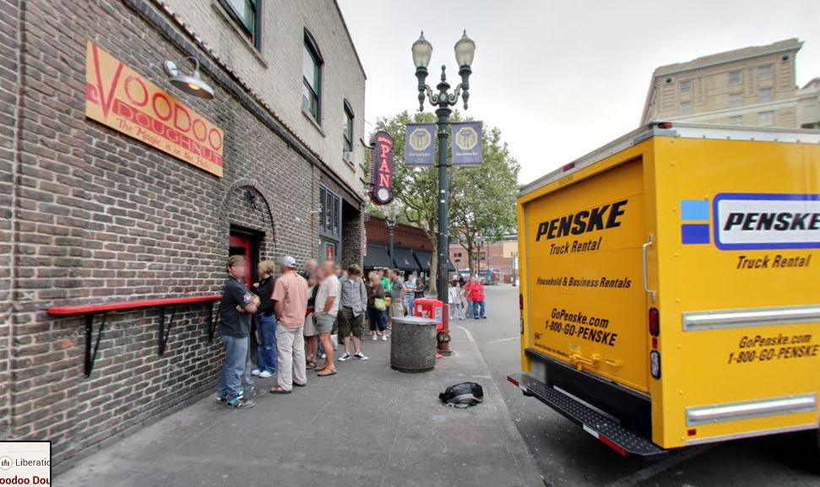
Is it walkable?

Slide 18
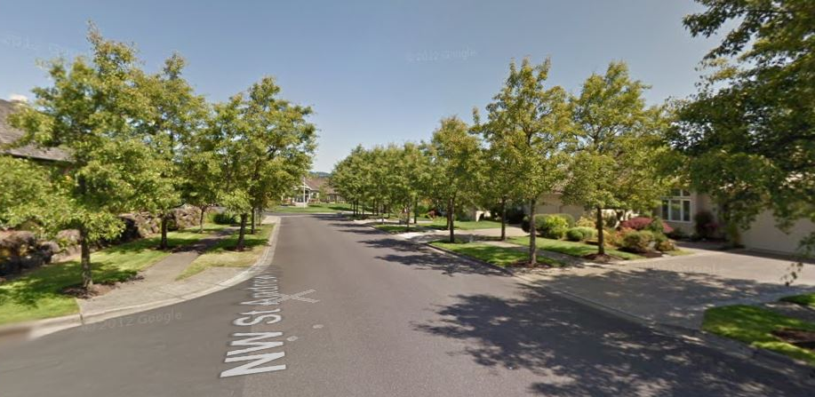
Is it walkable?

